Slide 1

RUNGTA COLLEGE OF DENTAL SCIENCES & RESEARCH
TITLE OF THE TOPIC: Composites
DEPARTMENT OF CONSERVATIVE DENTISTRY AND ENDODONTICS

Slide 2
Specific learning Objectives
At the end of this presentation the learner is expected to know
Core areas* H | Domain ** | Category #
Definition, indication, contraindication, composition, Classification | Cognitive | Must know
Cavity preparation, clinical procedure, bonding agent | Psychomotor | Nice to know
Methods of polymerization | Affective | Desire to know
*Subtopic of importance
** Cognitive, Psychomotor or Affective
# Must know , Nice to know & Desire to know

Slide 3
Table of Content
What are composites
Definitions
Indications
Contraindications
Advantages
Disadvantages of dental composites.
Components of composites

Slide 4
INTRODUCTION
Composites are presently the most popular tooth colored materials, having completely replaced silicate cement and acrylic resin.
Basically, composite restorative materials consist of a continuous polymeric or resin matrix in which an inorganic filler is dispersed.

Slide 5
KEY FACTS
Composites were derived from a latin word – ‘COMPOSITUS’, which means -
# COM = TOGETHER
# POUERO = TO PLACE.
ADA / ANSI SPECIFICATION NO. = 27
Composites were introduced in national bureau of standards (now called national institute of standard technology) by R.L Bowen in 1962.

Slide 6
DEFINITIONS
BY ANUSAVICE –
COMPOSITE
A solid compound formed from 2 or more distinct phases / materials (e.g.-Particles in a metal matrix), which are combined to produce properties superior to or those of the individual constituents.

Slide 7
DENTAL COMPOSITE
A highly cross-linked polymeric material reinforced by a dispersion of amorphous silica, glass, crystalline quartz or organic resin filler particles &/or short fibres bounded to the matrix by a coupling agent.

Slide 8
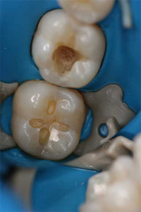
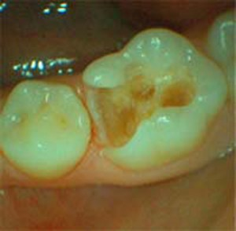
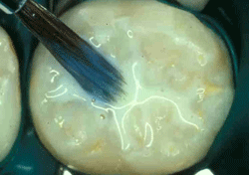
INDICATIONS
Initial Class – I & II lesions using modified conservative tooth preparations.
Pit &fissure sealants
As inlays in posterior teeth.

Slide 9
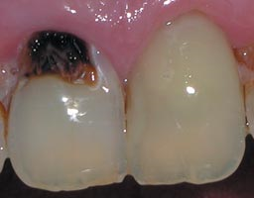
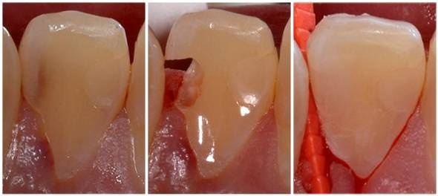
Indication
Moderate sized Class – I, II, V restorations.
Class – III, IV, VI restorations.
Preventive / conservative restorations.
Cements for indirect restorations & orthodontic brackets.

Slide 10
Indications
To build up cores in post core cases.
Esthetic enhancement areas & procedures like
veneers,
diastema closures,
tooth contour modifications
Repair of chipped porcelain restorations
Periodontal splinting.

Slide 11
ADVANTAGES
Esthetics.
Conservation of tooth structure.
Less complex tooth preparations.
Insulative, with decreased thermal conductivity.
Easily repairable.

Slide 12
Advantages
Bonding to tooth structure resulting in
# Good retention.
# Low microleakage.
# Minimal interfacial staining.
# Increased strength of remaining tooth structure.

Slide 13
CONTRAINDICATIONS
If operating site cannot be isolated from contamination by oral fluids.
If all the occlusion contacts will be on the restorative material.
Large posterior restorations
Bruxism
Poor isolation
High caries index

Slide 14
DISADVANTAGES
Potential gap formation
More difficult and time consuming
Technique sensitive
Greater occlusal wear
High coefficient of thermal expansion

Slide 15
Potential gap formation :-
The cause is – forces of polymerization shrinkage of material during the curing.

Slide 16
More difficult, time consuming,
Tooth treatment requires multiple steps.
Difficult insertion.
Establishing contacts & contours may be more difficult.
Finishing & polishing procedures are more difficult.

Slide 17
Technique sensitive –
Isolation of operating site,
Placement of etchant,
Bonding procedures,
Placement of material is very demanding of proper technique.

Slide 18
Greater occlusal wear –
In areas of high occlusal stress or when all of the tooth’s occlusal contacts are on the restoration.

Slide 19
Disadvantages
High linear coefficient of thermal expansion –
Co-effiecient of thermal expansion = 25 - 35 x 10⁻⁶/c
It can result in potential marginal percolation if an inadequate bonding technique is performed.
.

Slide 20
FACTORS AFFECTING LONGEVITY
MATERIAL RELATED FACTORS
NATURE & EXTENT OF INITIAL Lesion
TYPE OF MATERIAL USED.
DEPENDING UPON THE MASTICATORY LOAD

Slide 21
PATIENT’S FACTORS
ORAL HYGIENE
PROPER DIET
OCCLUSION & ADVERSE HABITS.

Slide 22
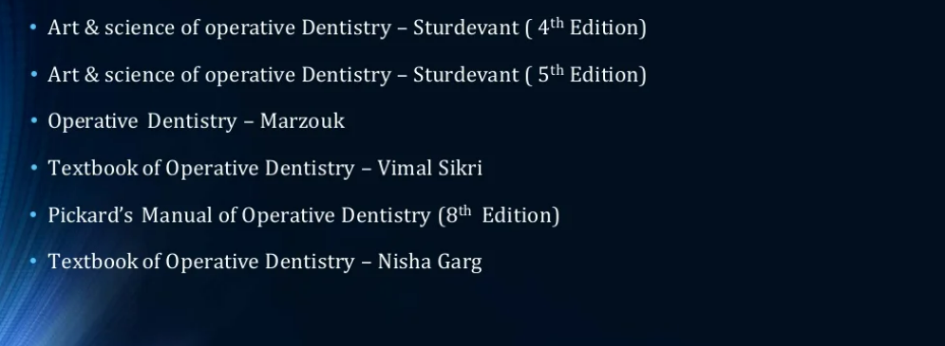
Teaching Materials

Slide 23
TAKE HOME MESSEGE/ FOR THE TOPIC COVERED (SUMMARY)
There is a wide scope of composite material in automotive, aerospace, wind energy, electrical, sports, domestic purpose, civil construction, medical chemical industries etc. Composite materials have a great potentiality of application in structures subjected primarily to compressive loads.
Composite materials have attractive aspects like the relatively high compressive strength, good adaptability in fabricating thick composite shells, low weight, low density and corrosion resistance.
Composite materials have good mechanical, electrical, chemical properties, due to which we can use composite material in many various industries.

Slide 24
Question & Answer Session
Definition of composite
Indication,Contra-indication, advantages and disadvantages of composite

Slide 25
REFERENCES

Slide 26
THANK YOU

